Slide 1
Smash the Crash
By team 0% Risk
Team member: Ian Chern
Jiawen Zhuo
Hoi Yin (Angel) Pong
YingXuan Li

Slide 2
Content
Purpose
Data selected
Common car crash natures
Common car crash causes
Data analysis
Future changes
Bibliography

Slide 3
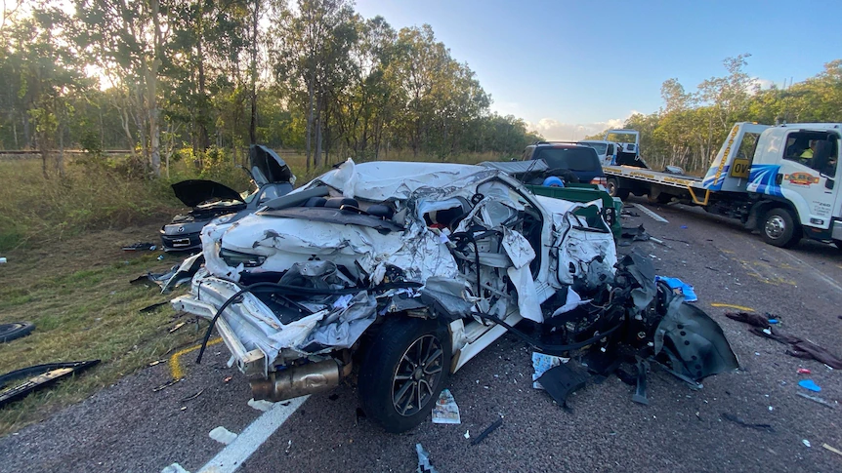
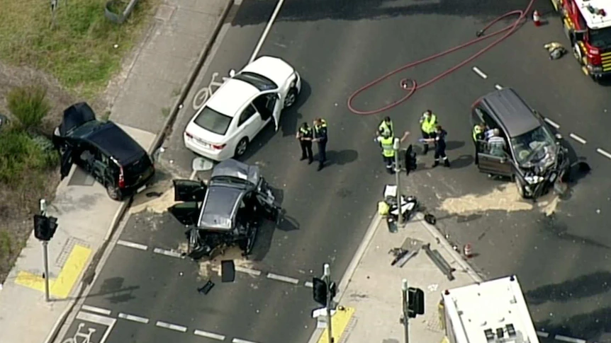
Purpose
The purpose of this project is to provide a summary of the historical car crash data from Queensland roads, and to design an original tech-solution that can help minimise or prevent the frequency of car crash accidents.
https://www.google.com/url?sa=i&url=https%3A%2F%2Fwww.abc.net.au%2Fnews%2F2021-06-23%2Fqld-townsville-triple-fatal-road-accident-man-in-custody%2F100236392&psig=AOvVaw2M3yQo907HD7pIVdLs9k3p&ust=1629696067504000&source=images&cd=vfe&ved=0CAsQjRxqFwoTCJiqxIzxw_ICFQAAAAAdAAAAABAi
https://www.google.com/url?sa=i&url=https%3A%2F%2Fwww.abc.net.au%2Fnews%2F2021-03-07%2Fpolice-plea-after-horror-long-weekend-on-victorian-roads%2F13225064&psig=AOvVaw2M3yQo907HD7pIVdLs9k3p&ust=1629696067504000&source=images&cd=vfe&ved=0CAsQjRxqFwoTCJiqxIzxw_ICFQAAAAAdAAAAABAp

Slide 4
Data selected
The data presented within this project has been extracted from the Queensland Government’s Open Data Portal. The datasets contain information on location and characteristics of crashes in Queensland for all reported Road Traffic Crashes occurred from 1 January 2001 to 31 December 2020, Fatal Road Traffic Crashes to 31 December 2020, Hospitalisation, Medical Treatment and Minor Injury Crashes to 31 December 2020 and Property Damage only crashes to 31 December 2010. It is to note that not all characteristics are to be analysed in this project due to restricted time frame and extremely large size of datasets.
https://www.tmr.qld.gov.au/Safety/Transport-and-road-statistics/Road-safety-statistics.aspx

Slide 5
High fatalities of Car Crash
According to the Latest Weekly Road Facility Report from the Depart of Transport and Main Roads, during 1 January 2020 to 31 December 2020, there were 277 fatalities as a result of crashes within Queensland, which is 57 fatalities (or 25.9%) greater than the same period for the previous year and 36 fatalities (or 14.8%) greater than the previous five-year average or the same period.
https://www.tmr.qld.gov.au/Safety/Transport-and-road-statistics/Road-safety-statistics.aspx

Slide 6
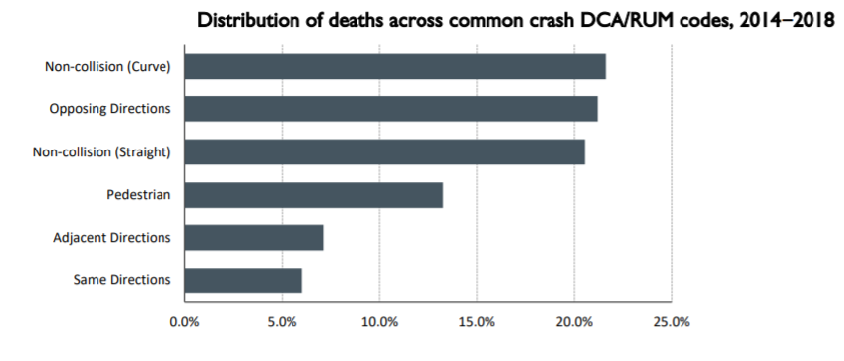
Common car crash natures
According to Australia 2019 Road Trauma Summary, Road crashes often involved six types of situations:
Pedestrians
Same Directions
Rear-end collisions, Sideswipe
Adjacent Directions
Side-on crashes
Opposing Directions
Head-on crashes
Non-collision
Off-path straight & curved crashes
https://www.bitre.gov.au/sites/default/files/documents/road_trauma_australia_2019_statistical_summary.pdf

Slide 7
Six most common causes of road accidents
Speeding
Drunk driving
Failing to give way
Fatigue and drowsiness
Distraction
Vehicle defects
https://eclipsedrivingschool.com.au/blog/road-accidents-australia/

Slide 8
Speeding
Speeding is the most common cause of fatal road accidents in Australia. There are certain risks you face as the driver:
You can lose control of the vehicle
You reduce your capacity to break within a safe distance behind another vehicle
You increase the distance necessary to stop your vehicle safely
You decrease the reaction time you need to adjust to sudden changes on the road
You expose yourself and your passengers to undue road accident risks and possibly severe damage and injuries
During 1 January 2020 to 31 December 2020, there were 69 fatalities as a result of crashes involving speeding drivers/riders within Queensland, which is 18 fatalities (or 35.3%) greater than the same period for the previous year and 13 fatalities (or 23.2%) greater than the previous five-year average or the same period.
https://www.tmr.qld.gov.au/Safety/Transport-and-road-statistics/Road-safety-statistics.aspx
https://eclipsedrivingschool.com.au/blog/road-accidents-australia/

Slide 9
Drunk driving
Driving under the influence of alcohol is another major cause of fatal road accidents in Australia.
During 1 January 2020 to 31 December 2020, there were 62 fatalities as a result of crashes involving drink drivers/riders within Queensland, which is 16 fatalities (or 34.8%) greater than the same period for the previous year and 11 fatalities (or 21.6%) greater than the previous five-year average or the same period.
https://www.tmr.qld.gov.au/Safety/Transport-and-road-statistics/Road-safety-statistics.aspx
https://eclipsedrivingschool.com.au/blog/road-accidents-australia/

Slide 10
Failing to give way
Failing to give way is a traffic offence anywhere in Australia and it stems from not observing comm road courtesy:
At intersections when traffic lights are not working, or there is no stop sign or give way sign
When pedestrians are rushing to cross even as the traffic lights are flashing yellow
When there is a clear give way sign
When you are changing lanes
https://eclipsedrivingschool.com.au/blog/road-accidents-australia/

Slide 11
Fatigue and drowsiness
When a person is tired but drive anyway, the effect is similar to that of driving while under the influence of alcohol.
During 1 January 2020 to 31 December 2020, there were 36 fatalities as a result of fatigue related crashes involving drivers/riders within Queensland, which is 6 fatalities (or 20.0%) greater than the same period for the previous year and 7 fatalities (or 25.0%) greater than the previous five-year average or the same period.
https://www.tmr.qld.gov.au/Safety/Transport-and-road-statistics/Road-safety-statistics.aspx
https://eclipsedrivingschool.com.au/blog/road-accidents-australia/

Slide 12
Distraction
The improper use of mobile phones is another major cause of distracted driving. Other causes of distracting include eating, arguing or conversing with a passenger and minding kids or pets in the back seat while driving.
During 1 January 2020 to 31 December 2020, there were 23 fatalities as a result of crashes involving distracted/inattentive drivers/riders within Queensland, which is 2 fatalities (or 9.5%) greater than the same period for the previous year and -6 fatalities (or -21.8%) less than the previous five-year average or the same period.
https://www.tmr.qld.gov.au/Safety/Transport-and-road-statistics/Road-safety-statistics.aspx
https://eclipsedrivingschool.com.au/blog/road-accidents-australia/

Slide 13
Vehicle defects
Problems with the vehicle can also add to the risks for driving. For examples:
Defective brakes
A faculty ignition switch
Wheel alignment issues.
https://eclipsedrivingschool.com.au/blog/road-accidents-australia/

Slide 14
Existing tech-solutions
AEB: automatic emergency braking systems
Backup cameras
Blind spot detection
Lane departure warnings
FCS: forward collision systems
Adaptive headlights
ECS: electronic stability control
Vehicle communication (V2V)
Traction control systems
Auto-steering
Rear cross-traffic alert
LED headlights
Rear AEB
ACC: autonomous cruise control
Voice control/Bluetooth
Anti-reckless teen driving tech
Interlock devices
Drowsiness video sensor
Gear shift palm detection
Phone suppression technology
https://arashlaw.com/20-safe-driving-technologies-available-for-cars-that-help-prevent-accidents/

Slide 15
What we have done...

Slide 16
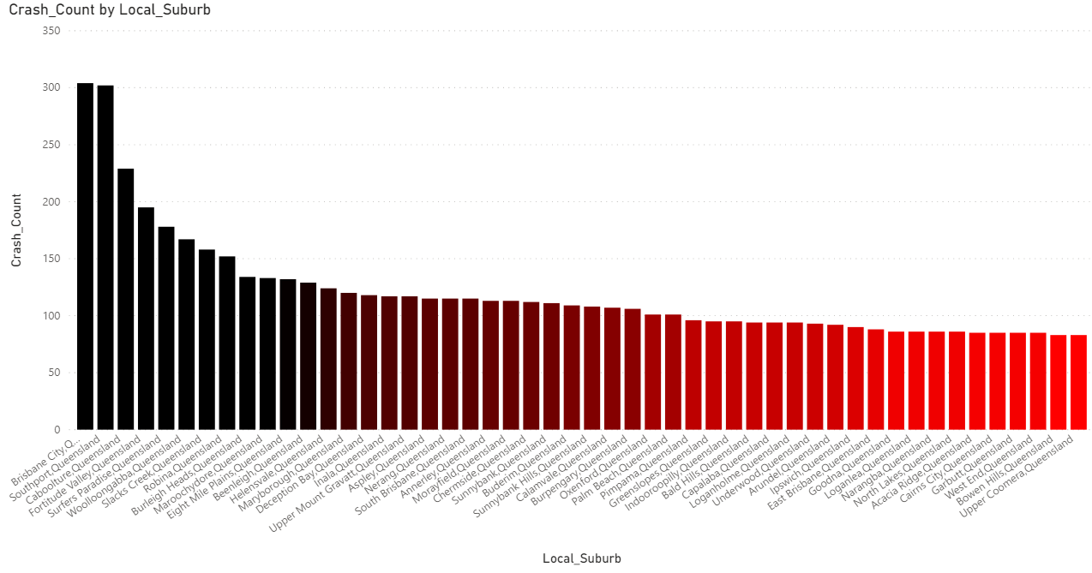
Total Crash Count and Location for the previous five years
We first present the crash count numbers across each suburb from 2010. The visualized data inspired us that there are certain suburbs has significantly more crashes than other suburb.

Slide 17
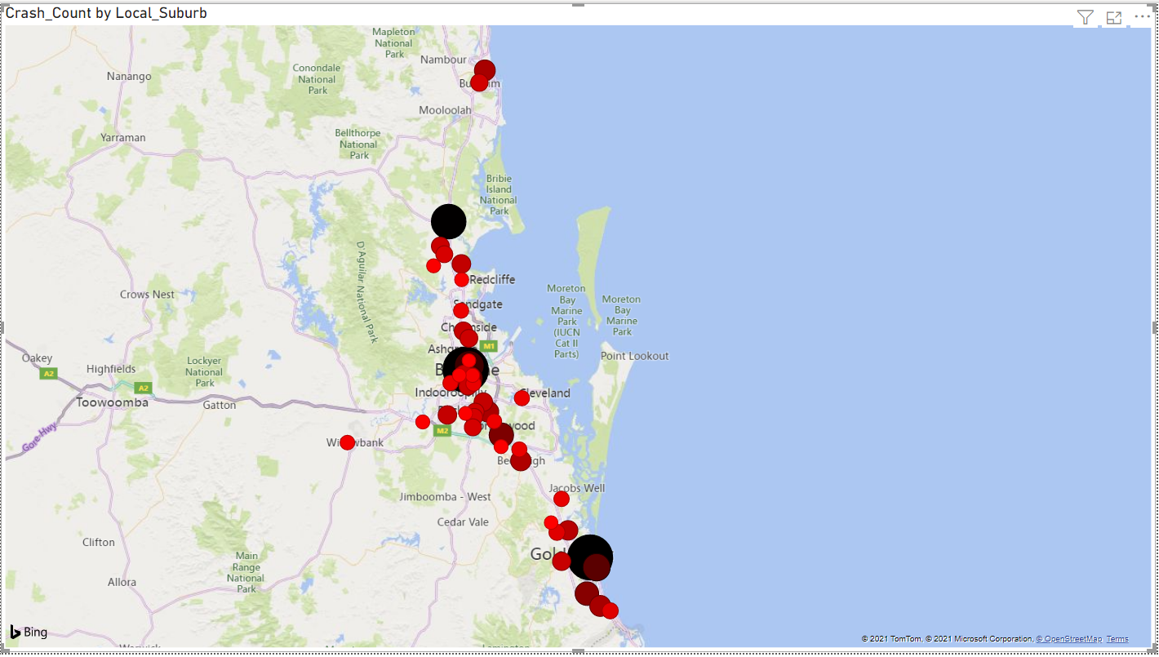
Total Crash Count and Location for the previous five years

Slide 18
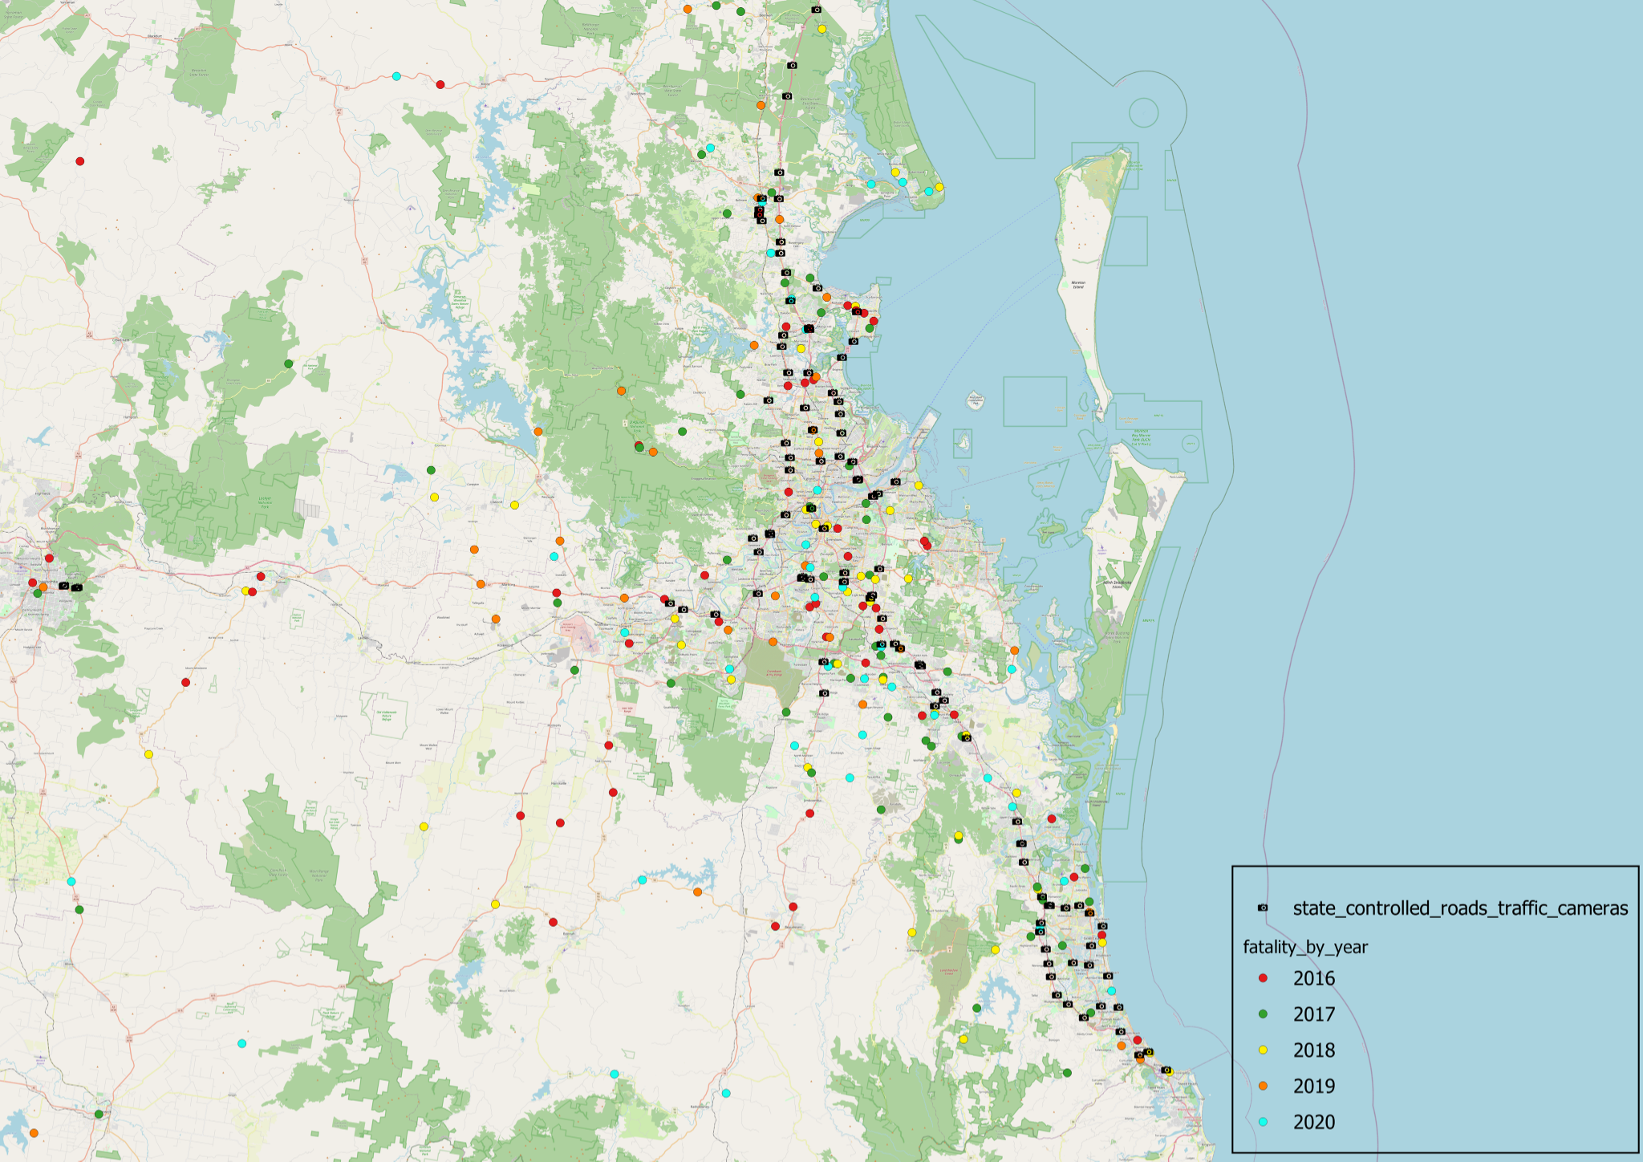
Total Car Crash and Location for the previous five years

Slide 19
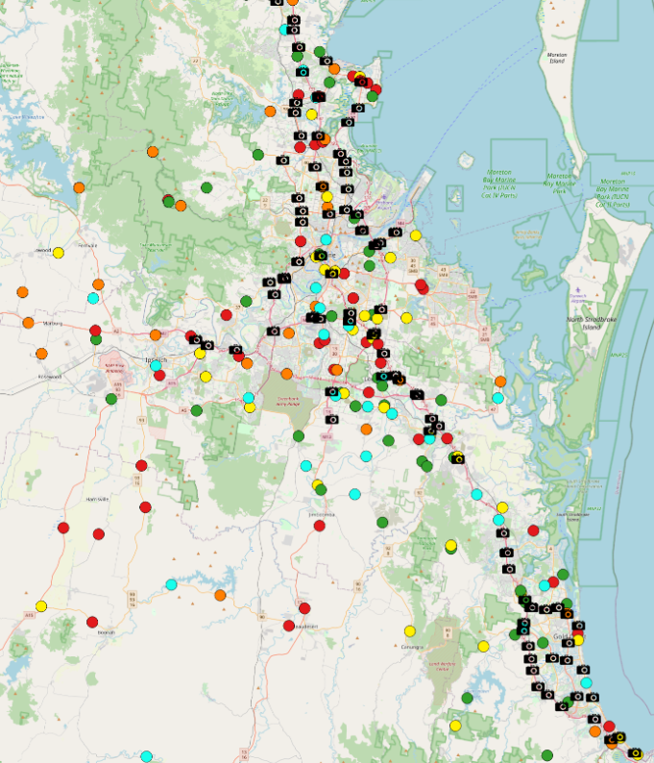
Total Fatal Crash Count and Cameras for the previous five years
We look into whether there are any potential relationships or correlations between cameras’ geographical distribution and crashes’ locations.
The locations of crashes and cameras have significantly overlapped. Interestingly, there are some areas with frequent car crashes but may not have any cameras. Overall, the map suggests that cameras can significantly reduce the possibility of car crashes and injuries.
Government should have more cameras in high risk areas to prevent car crashes.
P.S. the map only comprises of data from 2016 until 2020.

Slide 20
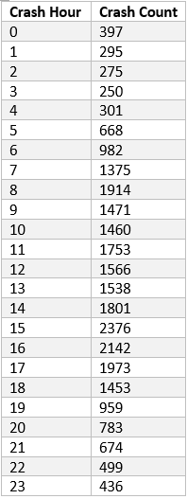
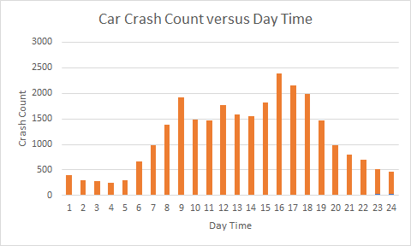
Total Crash Count and Day Time for the previous five years
Car crashes were most frequent during 4pm of the day as the number of car crashes tend to be higher compared to other times of the day. The second highest car crash time happened during 5pm of the day. Therefore, car crashes tend to occur during peak time of the day.
P.S. the bar chart only comprises of data from 2016 until 2020.

Slide 21
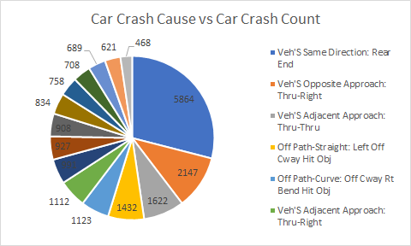
Car Crash Cause and Car Crash Count for the previous five years
As shown above, the most common car crash cause is rear end with vehicle(s) being in the same direction. The second most common car crash cause is through right with vehicle(s) coming from an opposite direction.
P.S. the pie chart only comprises of data from 2016 until 2020.

Slide 22
Looking into the future...

Slide 23
Our insights and Potential Changes
We are well aware that further analysis have to be done to make more meaningful conclusion to inform the government our insights or any interesting findings. However, based on our work, out team thinks that there are a few things which can be improved to reduce car crashes in the future.

Slide 24
Our insights and Potential Changes
Often, car crashes are caused by drivers instead of bad road constructions. The maps indicate several locations with frequent car crashes, particularly concentrated in areas near Brisbane City and Gold Coast.
The government may:
Conduct investigation as to how to prevent rear ending
Enhance police enforcement given more detailed analysis
Use machine learning to further investigate and provide advice; and
Extrapolate more features to gain more insights

Slide 25
Future advanced tech-solutions
There are a variety of tech-solutions already being employed by the legal enforcement units (e.g. police) to ensure drivers exercise proper and reasonable duty when they are on roads. However, more advanced tech-solutions include but not limited to:
AI emotion recognition to monitor drivers’ condition before driving
Video based vehicle detection particularly for use with existing traffic control system
Traffic incident detection and driver warning systems
Expert systems to improve the identification of traffic hazards and selection of appropriate countermeasures
An in-vehicle recorder of pre-crash vehicle characteristics
Automatic vehicle identification technology of speed detection
Other traffic control measures
https://trid.trb.org/view/355524
Notes:
Mention AI emotion recognition may cause other issues such as data privacy etc.

Slide 26

Current laws
Our team believes that the current laws are broad enough to capture most irresponsible drivers’ conduct. However, the laws should continue to adapt future technological changes in respect on road safety.
https://www.google.com/url?sa=i&url=https%3A%2F%2Fstudyqa.com%2Flaw&psig=AOvVaw2XzFCmTlv_V_MFj02zlrQk&ust=1629696444432000&source=images&cd=vfe&ved=0CAsQjRxqFwoTCNCTz8Lyw_ICFQAAAAAdAAAAABAJ

Slide 27
Bibliography
https://eclipsedrivingschool.com.au/blog/road-accidents-australia/
https://www.tmr.qld.gov.au/Safety/Transport-and-road-statistics/Road-safety-statistics.aspx
https://www.bitre.gov.au/sites/default/files/documents/road_trauma_australia_2019_statistical_summary.pdf
https://www.mynrma.com.au/cars-and-driving/driver-training-and-licences/resources/how-to-avoid-the-5-most-common-crashes
https://arashlaw.com/20-safe-driving-technologies-available-for-cars-that-help-prevent-accidents/
https://trid.trb.org/view/355524
https://www.google.com/url?sa=i&url=https%3A%2F%2Fwww.abc.net.au%2Fnews%2F2021-06-23%2Fqld-townsville-triple-fatal-road-accident-man-in-custody%2F100236392&psig=AOvVaw2M3yQo907HD7pIVdLs9k3p&ust=1629696067504000&source=images&cd=vfe&ved=0CAsQjRxqFwoTCJiqxIzxw_ICFQAAAAAdAAAAABAi
https://www.google.com/url?sa=i&url=https%3A%2F%2Fwww.abc.net.au%2Fnews%2F2021-03-07%2Fpolice-plea-after-horror-long-weekend-on-victorian-roads%2F13225064&psig=AOvVaw2M3yQo907HD7pIVdLs9k3p&ust=1629696067504000&source=images&cd=vfe&ved=0CAsQjRxqFwoTCJiqxIzxw_ICFQAAAAAdAAAAABAp
https://www.google.com/url?sa=i&url=https%3A%2F%2Fstudyqa.com%2Flaw&psig=AOvVaw2XzFCmTlv_V_MFj02zlrQk&ust=1629696444432000&source=images&cd=vfe&ved=0CAsQjRxqFwoTCNCTz8Lyw_ICFQAAAAAdAAAAABAJ

